Slide 1
The Effect Size
The effect size (ES) makes meta-analysis possible
The ES encodes the selected research findings on a numeric scale
There are many different types of ES measures, each suited to different research situations
Each ES type may also have multiple methods of computation

Slide 2
Examples of Different Types of Effect Sizes
Standardized mean difference
  Group contrast research
    Treatment groups
    Naturally occurring groups
  Inherently continuous construct
Odds-ratio
  Group contrast research
    Treatment groups
    Naturally occurring groups
  Inherently dichotomous construct
Correlation coefficient
  Association between variables research

Slide 3
Examples of Different Types of Effect Sizes
Risk ratio
  Group differences research (naturally occurring groups)
  Commonly used by epidemiologist and medical meta-analyses
  Inherently dichotomous construct
  Easier to interpret than the odds-ratio

Slide 4
Examples of Different Types of Effect Sizes
Proportion
  Central tendency research
    HIV/AIDS prevalence rates
    Proportion of homeless persons found to be alcohol abusers
Standardized gain score
  Gain or change between two measurement points on the same variable
    Reading speed before and after a reading improvement class
Others?

Slide 5
What Makes Something an Effect Size for Meta-analytic Purposes
The type of ES must be comparable across the collection of studies of interest
This is generally accomplished through standardization
Must be able to calculate a standard error for that type of ES
  The standard error is needed to calculate the ES weights, called inverse variance weights (more on this latter)
  All meta-analytic analyses are weighted

Slide 6
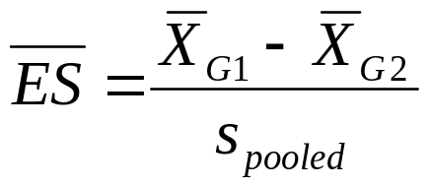
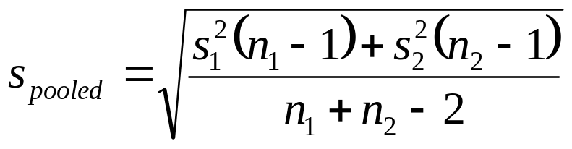
The Standardized Mean Difference
Represents a standardized group contrast on an inherently continuous measure
Uses the pooled standard deviation (some situations use control group standard deviation)
Commonly called “d” or occasionally “g”

Slide 7

The Correlation Coefficient
Represents the strength of association between two inherently continuous measures
Generally reported directly as “r” (the Pearson product moment coefficient)

Slide 8
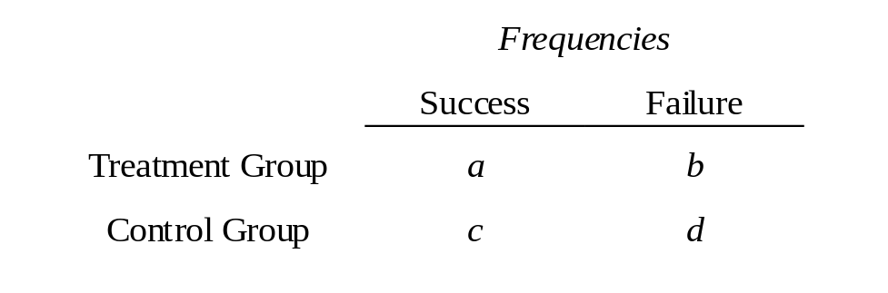
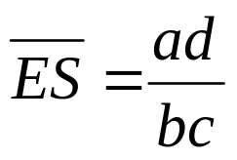
The Odds-Ratio
The odds-ratio is based on a 2 by 2 contingency table, such as the one below
The Odds-Ratio is the odds of success in the treatment group relative to the odds of success in the control group.

Slide 9
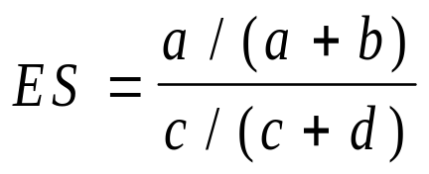
The Risk Ratio
The risk ratio is also based on data from a 2 by 2 contingency table, and is the ratio of the probability of success (or failure) for each group

Slide 10
Unstandardized Effect Size Metric
If you are synthesizing are research domain that using a common measure across studies, you may wish to use an effect size that is unstandardized, such as a simple mean difference (e.g., dollars expended)
Multi-site evaluations or evaluation contracted by a single granting agency

Slide 11
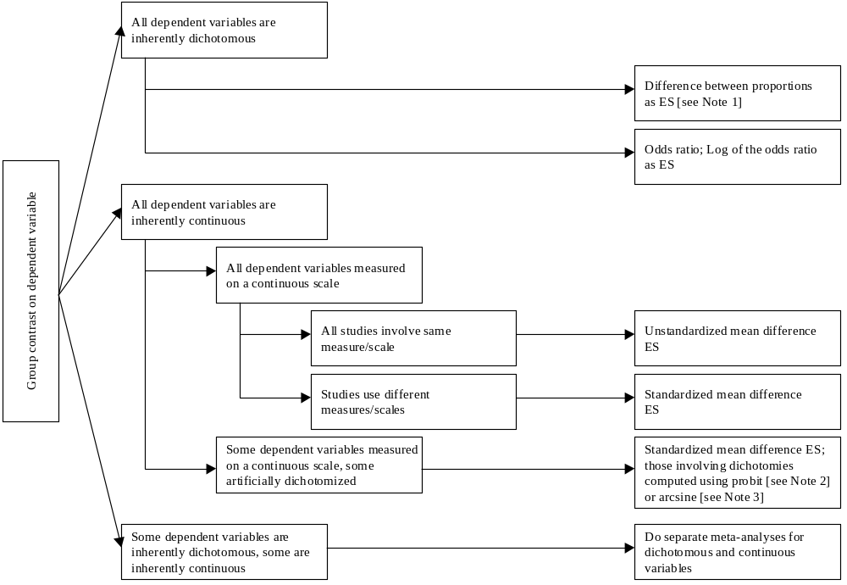
Effect Size Decision Tree for Group Differences Research (Page 58 of Book)

Slide 12
Methods of Calculating the
Standardized Mean Difference
The standardized mean difference probably has more methods of calculation than any other effect size type
See Appendix B of book for numerous formulas and methods.

Slide 13
Degrees of Approximation to the ES Value
Depending of Method of Computation
  Direct calculation based on means and standard deviations
  Algebraically equivalent formulas (t-test)
  Exact probability value for a t-test
  Approximations based on continuous data (correlation coefficient)
  Estimates of the mean difference (adjusted means, regression B weight, gain score means)
  Estimates of the pooled standard deviation (gain score standard deviation, one-way ANOVA with 3 or more groups, ANCOVA)
  Approximations based on dichotomous data
Great
Good
Poor

Slide 14
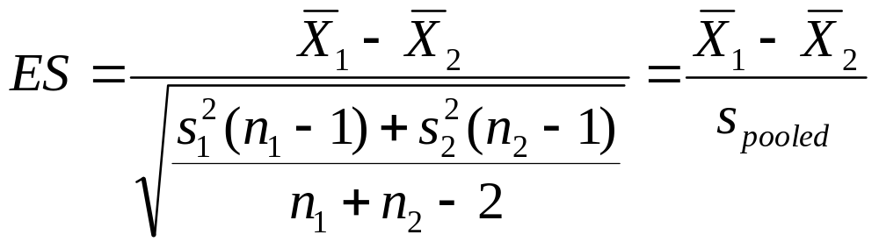
Methods of Calculating the
Standardized Mean Difference
Direction Calculation Method

Slide 15
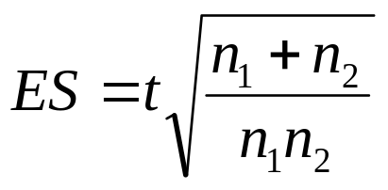
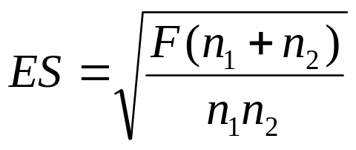
Methods of Calculating the
Standardized Mean Difference
Algebraically Equivalent Formulas:
independent t-test
two-group one-way ANOVA
exact p-values from a t-test or F-ratio can be converted
into t-value and the above formula applied

Slide 16
Methods of Calculating the
Standardized Mean Difference
A study may report a grouped frequency distribution
from which you can calculate means and standard
deviations and apply to direct calculation method.

Slide 17
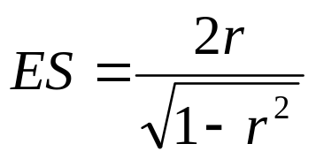
Methods of Calculating the
Standardized Mean Difference
Close Approximation Based on Continuous Data --
Point-Biserial Correlation. For example, the correlation
between treatment/no treatment and outcome measured
on a continuous scale.

Slide 18
Methods of Calculating the
Standardized Mean Difference
Estimates of the Numerator of ES -- The Mean Difference
  difference between gain scores
  difference between covariance adjusted means
  unstandardized regression coefficient for group membership

Slide 19
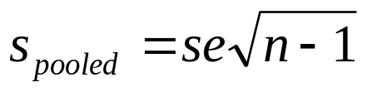
Methods of Calculating the
Standardized Mean Difference
Estimates of the Denominator of ES --
Pooled Standard Deviation
standard error of the mean

Slide 20
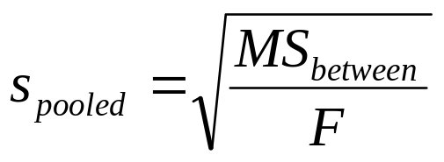
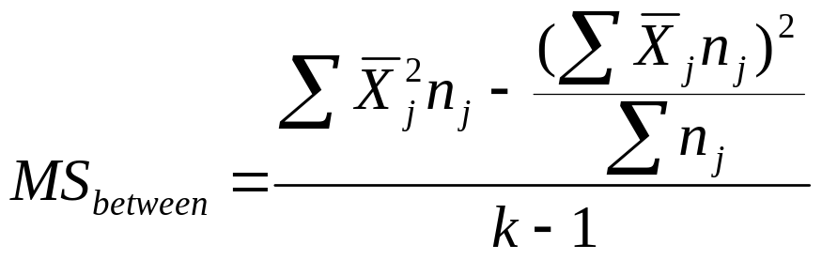
Methods of Calculating the
Standardized Mean Difference
Estimates of the Denominator of ES --
Pooled Standard Deviation
one-way ANOVA >2 groups

Slide 21
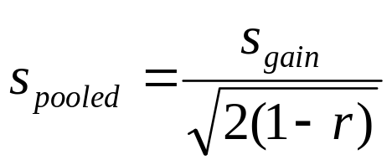
Methods of Calculating the
Standardized Mean Difference
Estimates of the Denominator of ES --
Pooled Standard Deviation
standard deviation of gain
scores, where r is the correlation
between pretest and posttest
scores

Slide 22
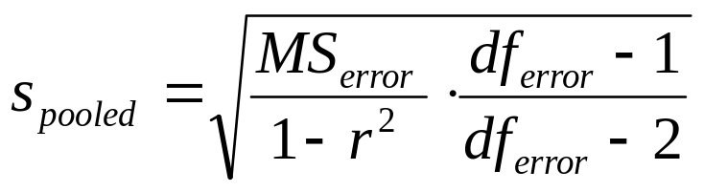
Methods of Calculating the
Standardized Mean Difference
Estimates of the Denominator of ES --
Pooled Standard Deviation
ANCOVA, where r is the
correlation between the
covariate and the DV

Slide 23
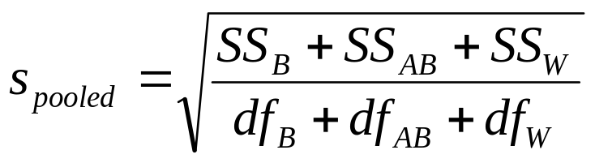
Methods of Calculating the
Standardized Mean Difference
Estimates of the Denominator of ES --
Pooled Standard Deviation
A two-way factorial ANOVA
where B is the irrelevant factor
and AB is the interaction
between the irrelevant factor
and group membership (factor
A).

Slide 24
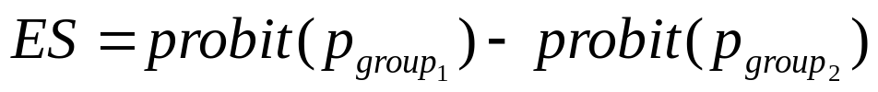
Methods of Calculating the
Standardized Mean Difference
Approximations Based on Dichotomous Data
the difference between the probits transformation
of the proportion successful in each group
converts proportion into a z-value

Slide 25
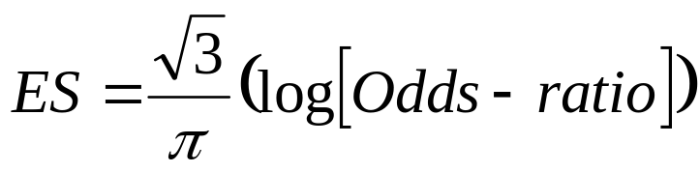
Methods of Calculating the
Standardized Mean Difference
Approximations Based on Dichotomous Data
this represents the rescaling of the logged
odds-ratio (see Sanchez-Meca et al 2004
Psychological Methods article)

Slide 26
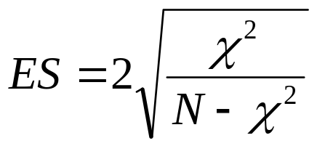

Methods of Calculating the
Standardized Mean Difference
Approximations Based on Dichotomous Data
chi-square must be based on
a 2 by 2 contingency table
(i.e., have only 1 df)
phi coefficient

Slide 27
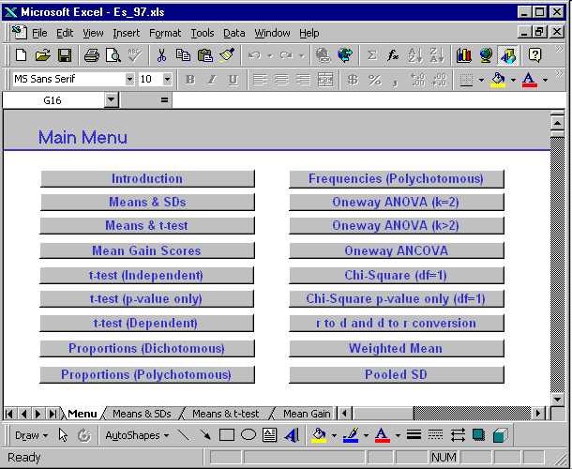

Slide 28
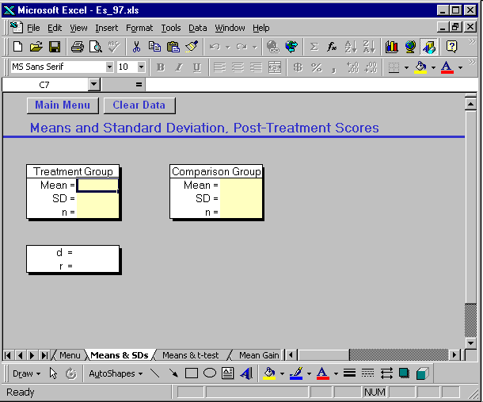

Slide 29
Formulas for the Correlation Coefficient
Results typically reported directly as a correlation
Any data for which you can calculate a standardized mean difference effect size, you can also calculate a correlation type effect size
See appendix B for formulas

Slide 30
Formulas for the Odds Ratio
Results typically reported in one of three forms:
  Frequency of successes in each group
  Proportion of successes in each group
  2 by 2 contingency table
Appendix B provides formulas for each situation

Slide 31
Data to Code Along With the ES
The effect size
  May want to code the data from which the ES is calculated
  Confidence in ES calculation
  Method of calculation
  Any additional data needed for calculation of the inverse variance weight
Sample size
ES specific attrition
Construct measured
Point in time when variable measured
Reliability of measure
Type of statistical test used

Slide 32
Issues in Coding Effect Sizes
Which formula to use when data are available for multiple formulas
Multiple documents/publications reporting the same data (not always in agreement)
How much guessing should be allowed
  sample size is important but may not be presented for both groups
  some numbers matter more than others

